Slide 1

Voice-Activated Assistant:
Python Project:

Slide 2
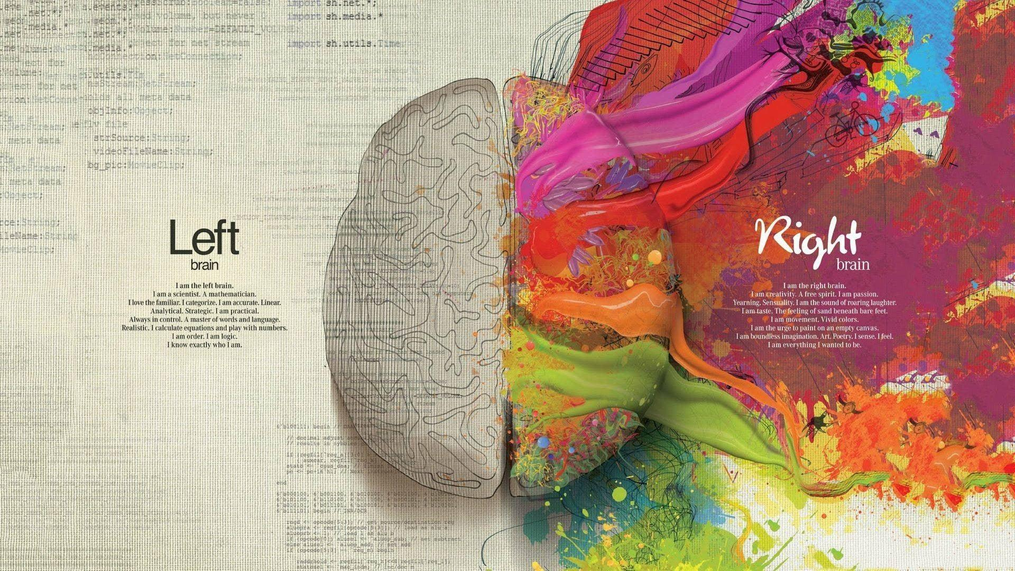
Introduction:
Step into the realm of user-friendly AI with our Python-based Simple Voice Assistant. Responding to voice commands, it efficiently opens and closes applications, offering a seamless and hands-free computing experience for everyday tasks.

Slide 3
Technologies Used:
List the technologies/libraries :
Python
Speech-Recognition library
Pyttsx3 library
webbrowser module
os module
subprocess module
pyautogui library
wikipedia-api

Slide 4
Code Overview:
1. Speech Engine
Initialization.
01
02
2. Browser Setup.
3. Function to Listen for
Commands.
03
04
4. Function to
Speak.

Slide 5

Voice Recognition:
“ Voice Recognition is a technology that converts spoken language into written text, enabling machines to interpret and respond to verbal commands.“

Slide 6
Opening Applications:
In our Simple Voice Assistant, opening applications is a breeze. With commands like "open Chrome" or "launch Notepad," the assistant utilizes Python's os and web browser modules to seamlessly start applications, adding a touch of efficiency and hands-free convenience to everyday computing.

Slide 7
Closing Applications:
Effortlessly managing open applications, our Simple Voice Assistant responds to commands like "close Chrome" or "shut down Notepad." Using Python's os and subprocess modules, the assistant gracefully terminates the specified applications, streamlining the user experience and providing a hands-free approach to application management.

Slide 8
Thank You…
So
Much…

